Slide 1

Efficiency improvement in existing
80 t/h bagasse fired low pressure boiler
DESCON Engineering Limited
Sugar conference Sept. 12, 2011

Slide 2
Present situation
Mostly sugar mills produce out of each kg of bagasse 2 kg of MP steam.
This means an boiler efficiency of approx 71% (based on LHV value of 1850 kcal/kg.
However efficiency would be 83% based on:
30% excess air
25 C ambient temperature
no unburned losses.
No economizer
So, approx 12% of the available heat is lost.
This is mainly caused by:
high unburned losses
high excess air

Slide 3
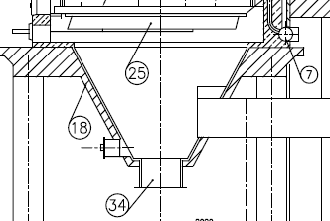
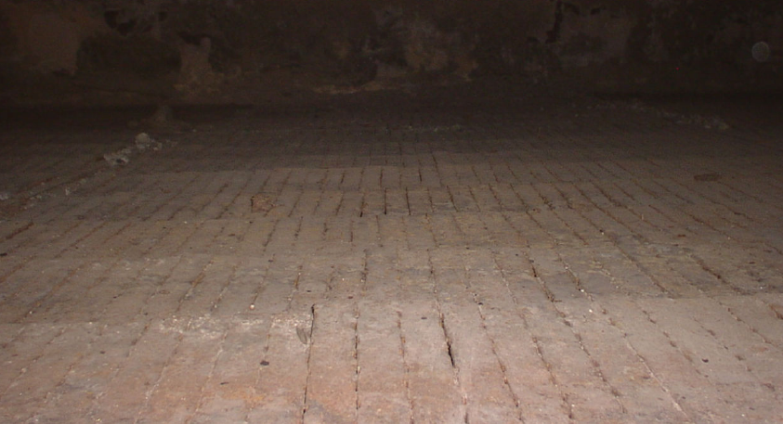
What are the root causes?
Unequal air flow distribution over grate.
Preheated air
2 Low pressure drop of dumping grate due to large number of spaces between the grate bars.
Grate bars

Slide 4
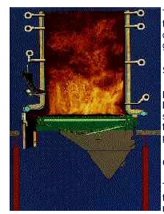
piling of ash and wet bagasse has high impact on air distribution over furnace area. Make air distribution more worse.
Pile size will only increase further and increase unburned.
Also over firing of grate bars is most likely to occur.
4. Unequal distribution of fuel over furnace area
Fuel spreading

Slide 5
5. No overfiring.
Means: No proper mixing of unburned gasses and unburned fly ash leaving furnace.
Over firing air
Over firing air

Slide 6
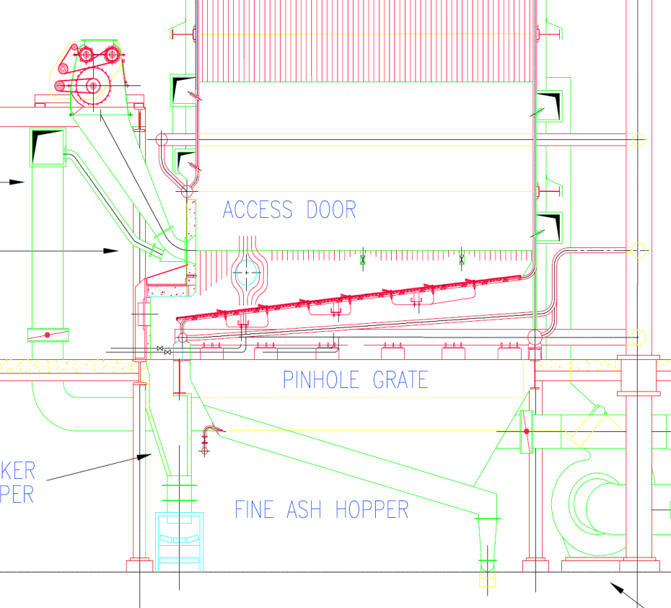
How to minimize those losses?
1. Apply a Water cooled inclined grate
A solid and simple design
no mechanically moving elements
water cooled tubes as supporting structure connected with boiler natural circulation system
No special hopper required under grate
Due to absence of hopper less height required
Even air distribution over grate system by increased pressure drop and proper designed air distribution box
On line ash removal system. No interruption in steam supply
Air temperature can be far above 200 C. No limitation.
Grate loading: 2,4 MW/m2
Excess air 30 till 40%
Unburned losses 3 till 4%

Slide 7
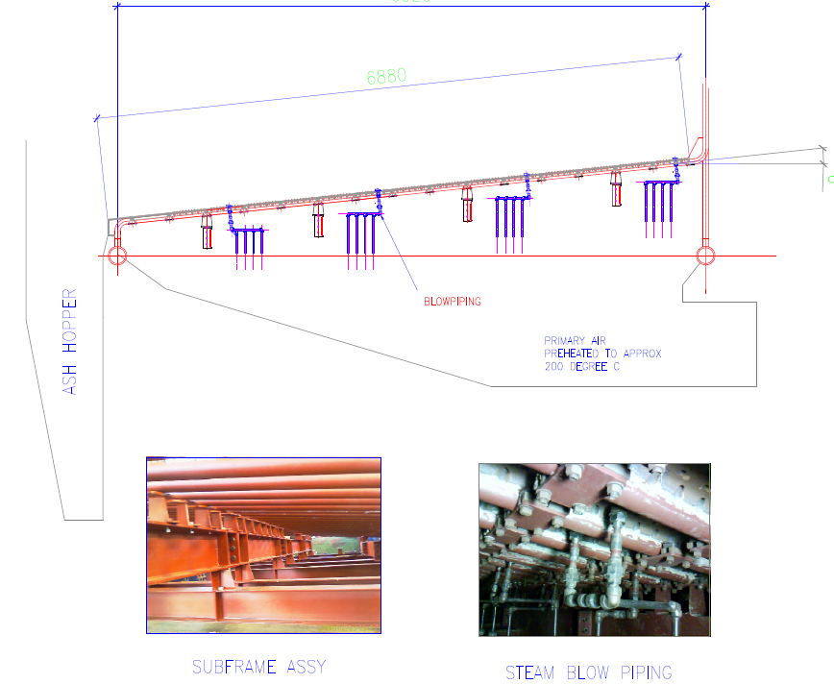
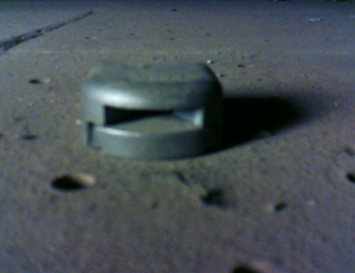
Ash removal system
Steam blow nozzles
blowing piping
Ash hopper
Primary air
Preheated till 200 C min
Supporting frame
Steam blow piping

Slide 8
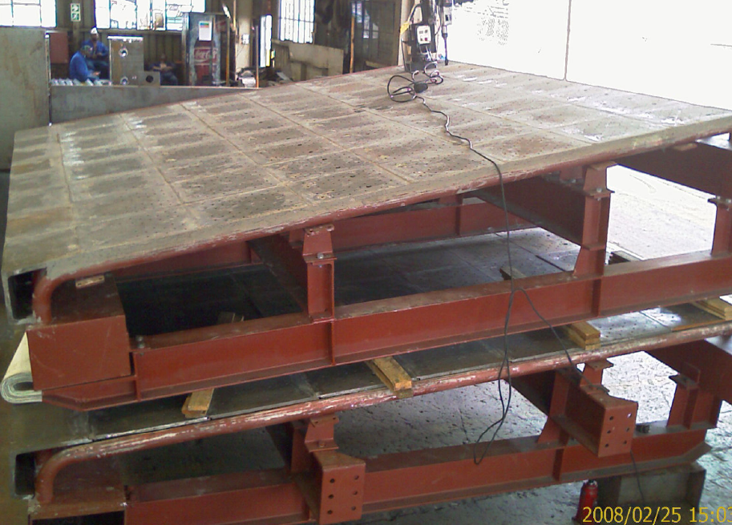
Example of water cooled inclined grate with alloy plates no.1

Slide 9
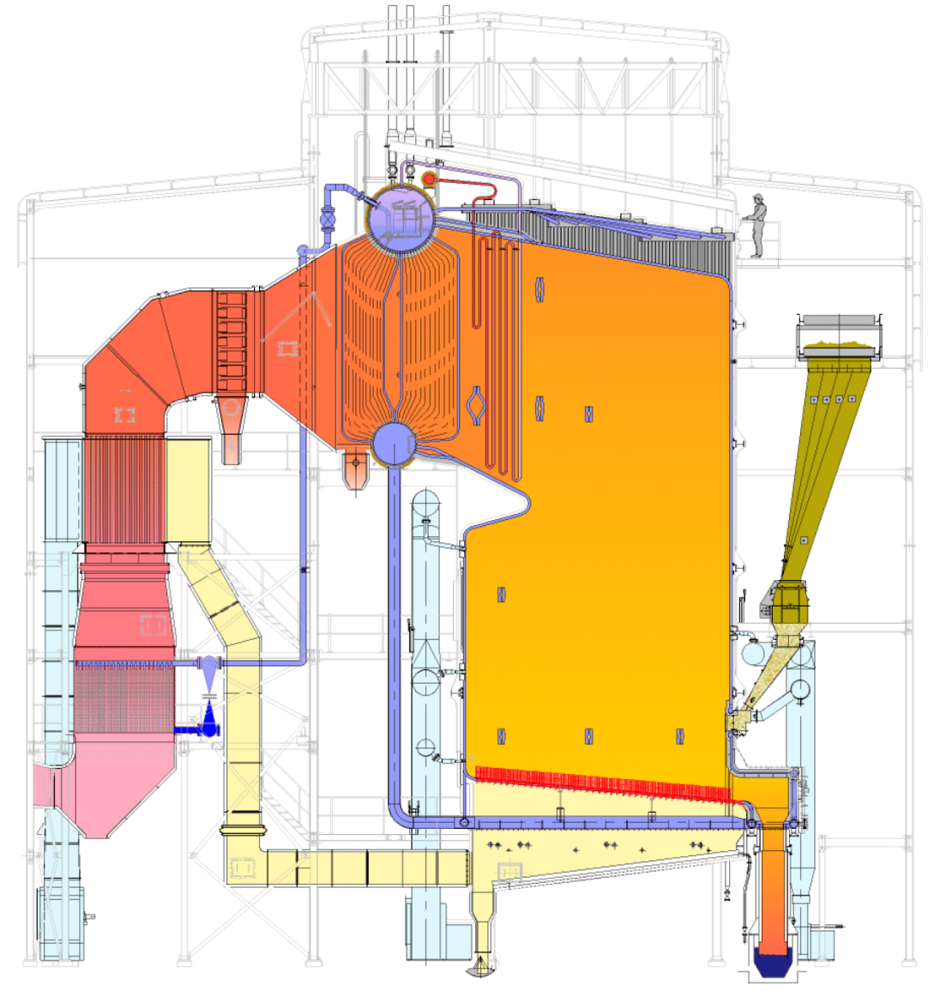
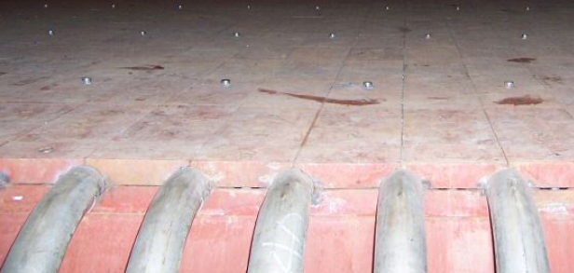
Example of water cooled inclined grate with alloy plates no. 2
113 t/h medium pressure boiler in Jaimaca

Slide 10
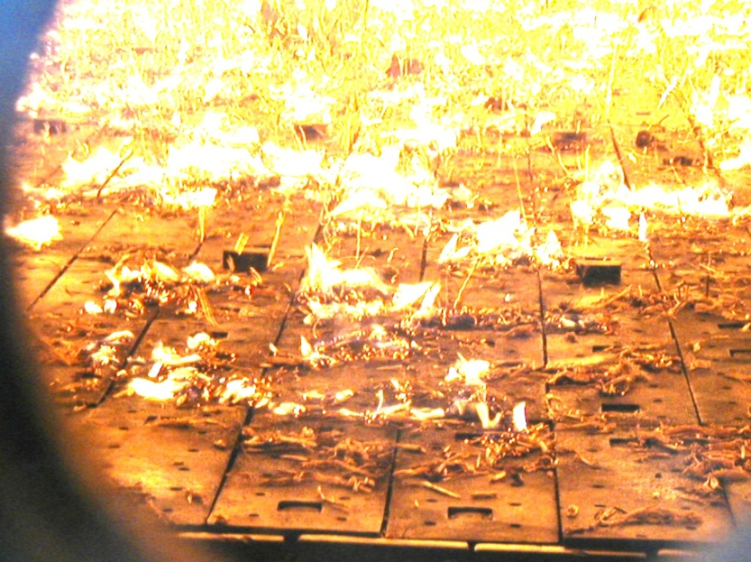
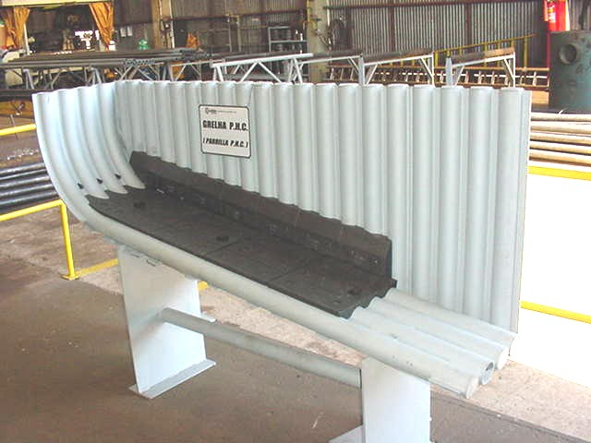
Example of water cooled inclined grate with alloy plates No.3
In Brasil is said:
Watercooled pinhole grate, the best solution for bagasse firing for cogeneration in sugar mills

Slide 11
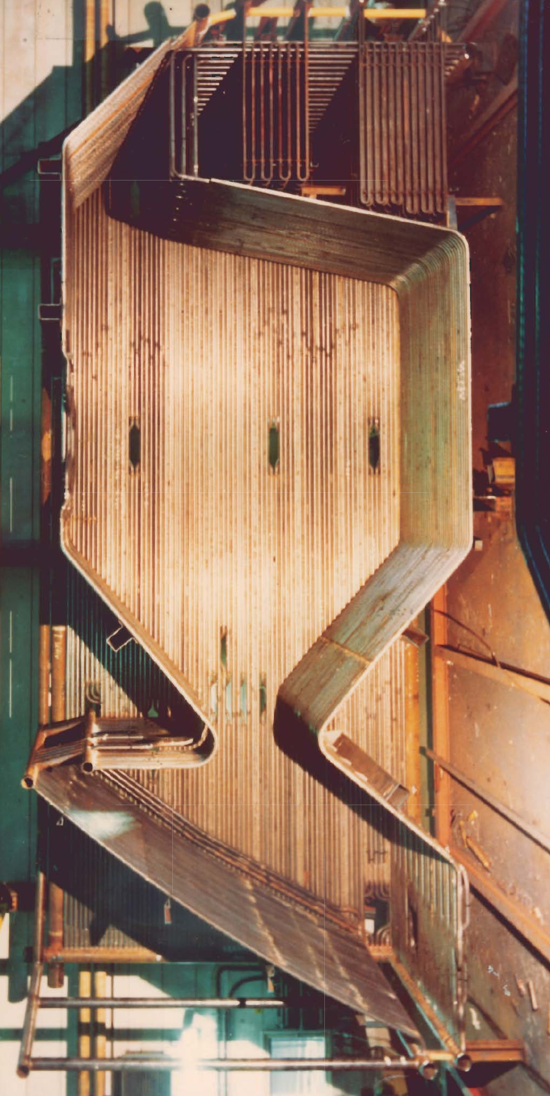
ERK water cooled inclined grate system as
all in one solution
In 80th specially designed by ERK for bark firing in Northern Europe.
Same grate system with small angle and steam cleaning is suitable for bagasse firing and other low ash biomass fuels

Slide 12
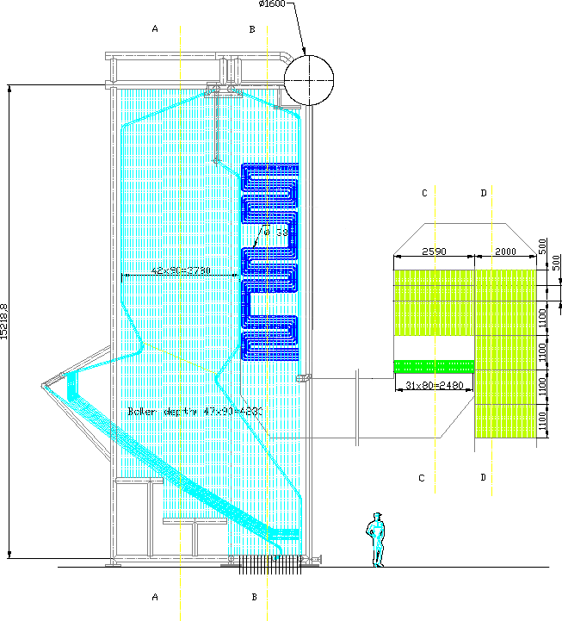
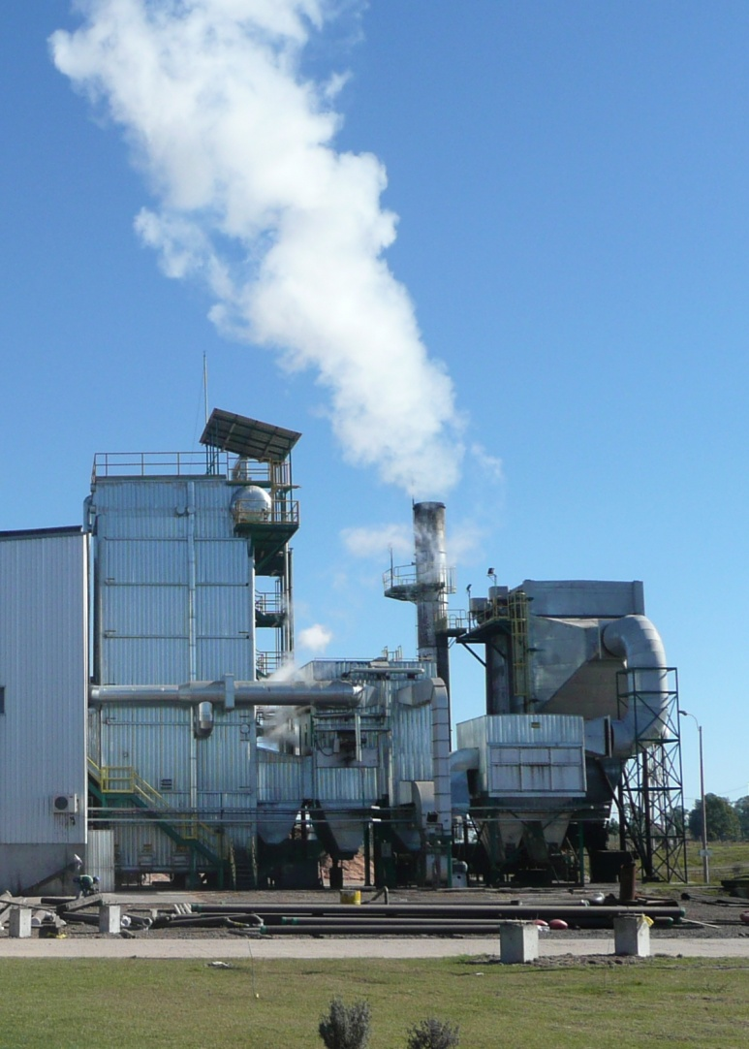
Example ERK grate system
Biomass 35t/h, 20bar, saturated

Slide 13
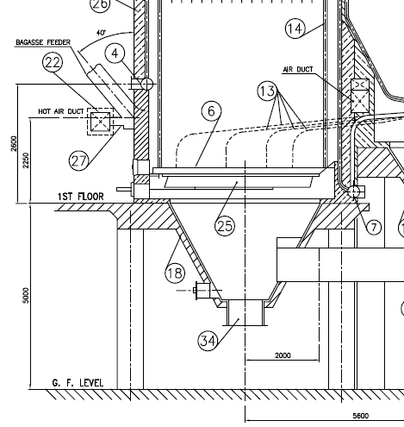
2. Equalize fuel spreading over full grate
Install a rotary wheel in spreading air line in order to fluctuate the amount of spreading air.
Further install separate fan for spreading with head of 70 mbar to improve spreading power
preheated air

Slide 14
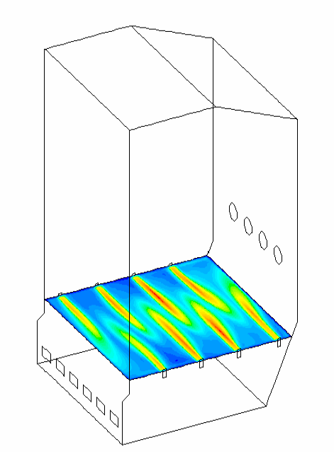
3. Install over firing system in sidewalls
For proper mixing of all unburned particles and gasses with air.
Nozzles of larger size and high air velocity to create a deep penetration of air into the furnace.

Slide 15
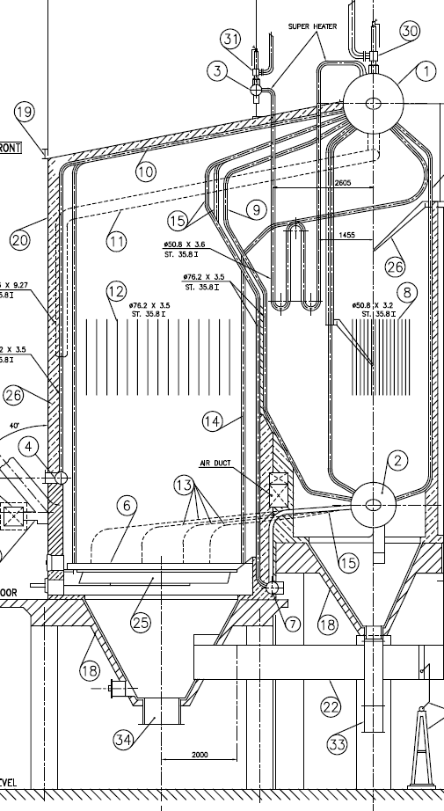
Overview of modifications
Over firing air
Nozzles in side wall
And new secondary fan of higher head
Equalizing fuel spreading
Water cooled inclined grate
If possible it should be set lower to get more time for burning out. Also feeders and overfiring
Wet ash removal
Additional baffles in hopper for improved air distribution

Slide 16
Main Advantages of water cooled inclined pinhole grate:
Very low maintenance. No renewal of parts.
Automatic ash removal
Easy control for operators
Drying of bagasse for efficiency improvement is not limited by grate.
Fuel saving up to 8 %
Proven design over more then 20 years

Slide 17
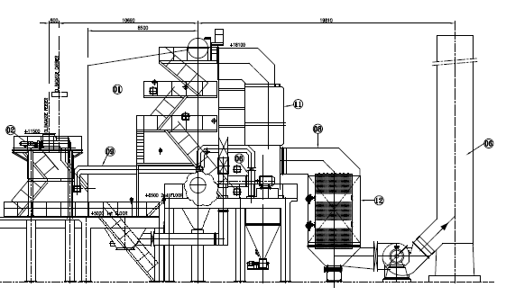
More efficiency improvement.
Install economizer at outlet boiler
Downstream the air pre-heater
Efficiency improvement 5 %.
Stack temperature decreased to 145 C.
Economizer of bare or finned tubes
Flue gas pressure drop increases with 4 mbar
Stack and ID fan relocated
Economizer.

Slide 18
Do not install economizer upstream the air-preheater.
Why?
The space is limited, so only a small economizer can be installed.
Improvement in efficiency maximum 2,3 %.
The air temperature at outlet pre-heater drops from 200 C to 160 C.
Due to lower air temperature the firing of bagasse will get poor at high moisture content of bagasse.
the unburned losses will increase. This will have negative effect on efficiency
Limited space

